Slide 1
Basics of python – 12/06/02

Slide 2
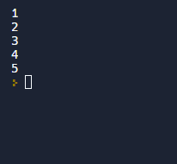

Q- Print the first 5 positive integers in ascending order with one number in each line
for i in range(1,6):
print(i,end='\n')#newline character

Slide 3
Q2 - Print the following pattern. * ** *** **** ***** There are no spaces between consecutive stars. There are no spaces at the end of each line.

Slide 4
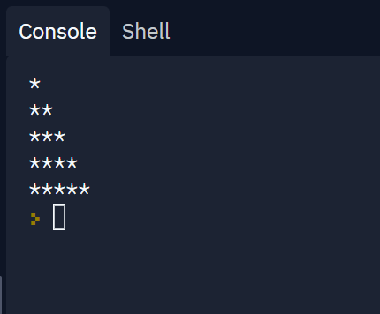
for i in range(0, 5):
for j in range(0, i+1):
# printing stars
print("*",end ="")
print("")

Slide 5
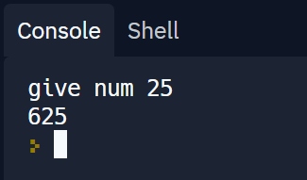
Q3 - Accept an integer as input and print its square as output.
x =int(input("give num "))
import math
y = pow(x,2)
print(y)

Slide 6
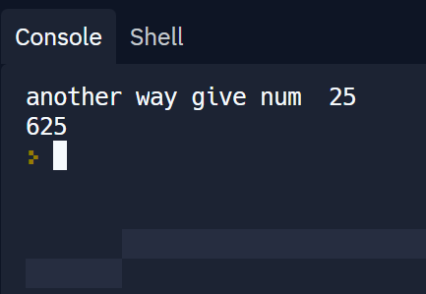
Another way using operators
x =int(input("another way give num "))
y = x**2
print(y)

Slide 7
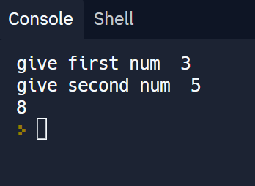
Q3 - Accept two integers as input and print their sum as output.
x =int(input("give first num "))
y =int(input("give second num "))
print(x+y)

Slide 8
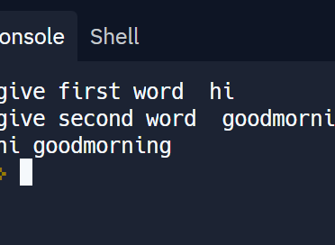
Q4 - Accept two words as input and print the two words after adding a space between them.
x =str(input("give first word "))
y =str(input("give second word "))
print(x+" "+y)

Slide 9
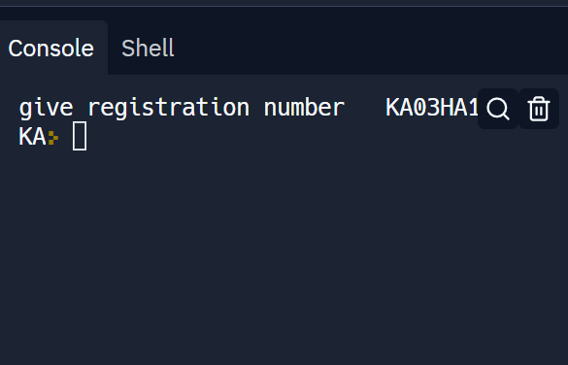
Q5 - Accept the registration number of a vehicle as input and print its state-code as output.
#Example: KA03HA1985
x =str(input("give registration number "))
for i in range(0,2):
print(x[i],end='')

Slide 10
Q6 - Accept a five digit number as input and print the sum of its digits as output.
When a number is divided by 10, the remainder of this gives the last digit and quotient of this division gives the first int digits excluding the last digit
Remainder - % modulo operator
Quotient - // floor division operator
Int is not iterable , so either take list as input

Slide 11
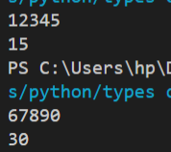
x = str(input())
sum = 0
for i in x:
y = int(x)%10
sum = sum + y
x = int(x)//10
print(sum)

Slide 12
Q7 : Accept a positive integer n as input and print all the factors of n, one number on each line [ factor : in mathematics, a number or algebraic expression that divides another number or expression evenly—i.e., with no remainder each number is a factor of itself

Slide 13
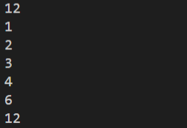
x = int(input()) for i in range(1,x+1): if x%i==0: print(i)

Slide 14
Q8 Accept two positive integers a and b as input. Print the sum of all integers in the range [1000,2000], endpoints inclusive, that are divisible by both a and b. If you find no number satisfying this condition in the given range, then print 0

Slide 15
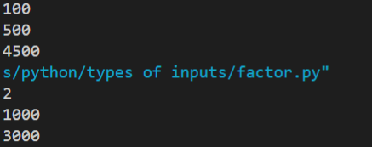
a = int(input())
b = int(input())
sum = 0
for i in range(1000,2001):
if(i%a==0 and i%b==0):
sum = sum+i
if (sum == 0):
print('0')
print(sum)

Slide 16
Q9 Accept a positive integer n as input, where n > 1. Print PRIME if n is a prime number and NOTPRIME otherwise.

Slide 17
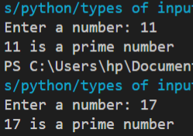
# To take input from the user
num = int(input("Enter a number: "))
# prime numbers are greater than 1
if num > 1:
# check for factors
for i in range(2,num):
if (num % i) == 0:
print(num,"is not a prime number")
print(i,"times",num//i,"is",num)
break
else:
print(num,"is a prime number")
# if input number is less than
# or equal to 1, it is not prime
else:
print(num,"is not a prime number")

Slide 18
Q10 :
In the first line of input, accept a sequence of space-separated words. In the second line of input, accept a single word. If this word is not present in the sequence, print NO. If this word is present in the sequence, then print YES and in the next line of the output, print the number of times the word appears in the sequence.

Slide 19

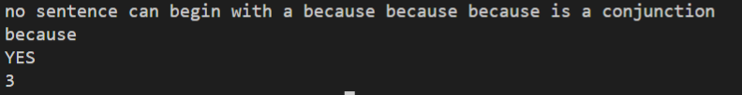
n = input().split()
w = input()
count = 0
for i in n:
if w == i :
count += 1
if count == 0:
print("NO")
else:
print("YES")
print(count)

Slide 20
Q11 :
You are given the names and dates of birth of a group of people. Find all pairs of members who share a common date of birth. Note that this date need not be common across all pairs. It is sufficient if both members in a pair have the same date of birth.
The first line of input is a sequence of comma-separated names. The second line of input is a sequence of comma-separated positive integers. Each integer in the sequence will be in the range [1, 365], endpoints inclusive, and stands for some day in the year.
Find all pairs of names that share a common date of birth and store them in a list called common. Each element of this list is itself a list, and should be of the form [name1, name2], such that name1 comes before name2 in alphabetical order.

Slide 21
(1) The pairs can be appended to the list common in any order. Only the names within a pair should be in dictionary order.
(2) You can assume that each test case will have at least one pair of members who share the same date of birth.
(3) You do not have to print the output to the console. This is the responsibility of the autograder. You just have to populate the list common in the required format.
Sample Input/Output
For example, consider the input:
sachin,ramesh,rohit,priya,saina,sandeep,stella
100,50,100,20,30,20,20
Your list common could look like this:
[['rohit', 'sachin'], ['priya', 'sandeep'], ['priya', 'stella'], ['sandeep', 'stella']]

Slide 22
names = input().split(',')
dob = input().split(',')
dob = [int(i) for i in dob]
n = len(names)
common = []
for i in range(n):
for j in range(n):
if dob[i] == dob[j] and i != j :
t = []
if names[i] < names[j]:
t.append(names[i])
t.append(names[j])
else:
t.append(names[j])
t.append(names[i])
if t not in common:
common.append(t)

